Slide 1
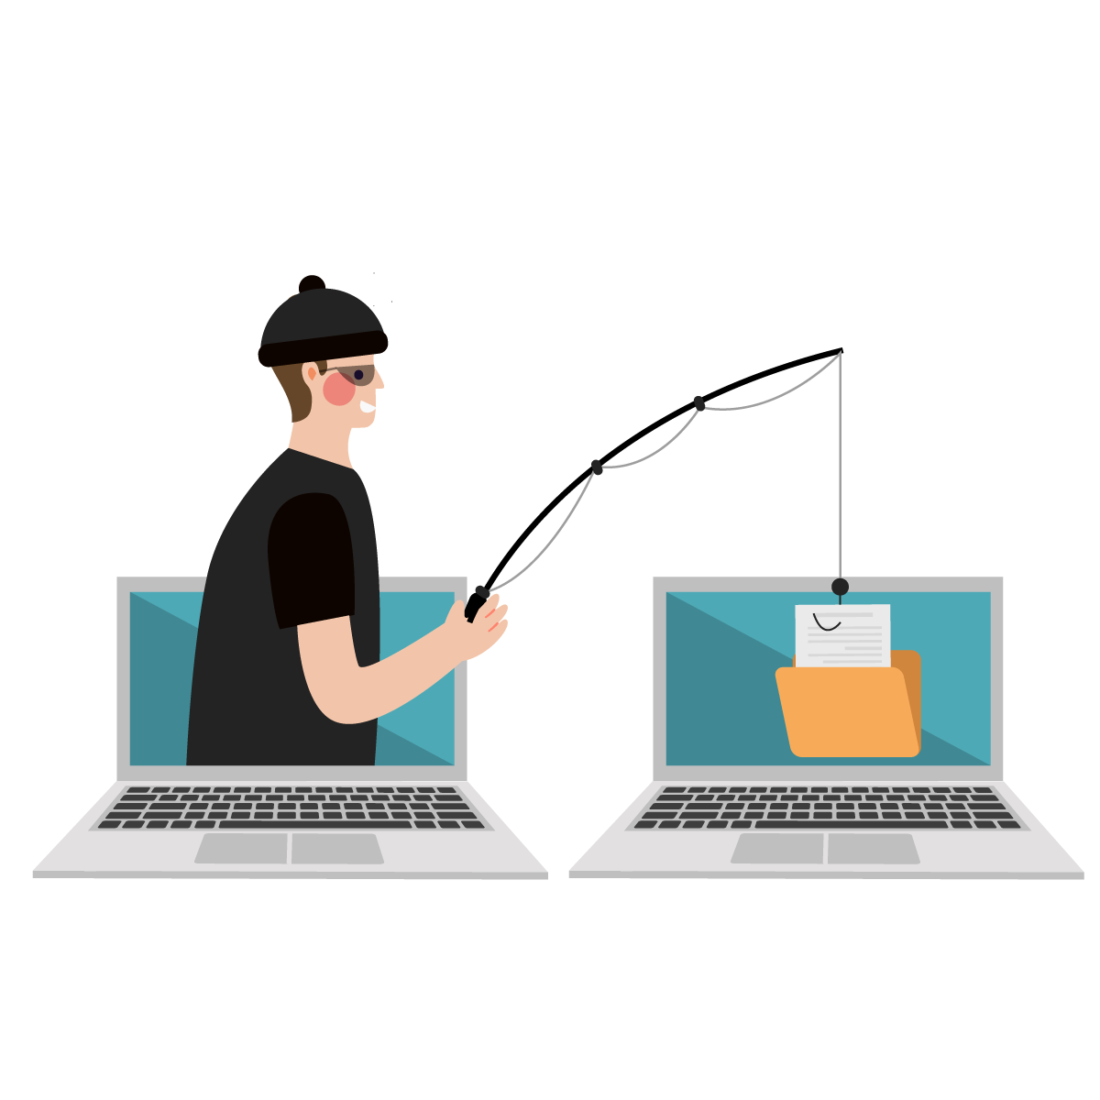
Phishing Awareness Training Protect Yourself from Online Threats
Protect Yourself from Online Threats

Slide 2
What is Phishing?
• Cyber attack where attackers trick you into giving personal info.
• Attackers pretend to be trusted sources.
• Main targets: Passwords, credit cards, sensitive data.

Slide 3
Common Phishing Methods
Fake Emails (urgent action needed).
Fraudulent Websites (look real).
Phone Calls pretending to be banks.
Fake Social Media Messages.

Slide 4
How to Recognize Phishing Emails
Check sender's email address.
Look for grammar or spelling mistakes.
Avoid clicking unknown links/attachments.
Be suspicious of 'urgent' or 'threatening' language.

Slide 5
Real Example of a Phishing Email
Fake domain names.
Urgent or threatening messages.
Poor grammar and spelling.

Slide 6
How to Protect Yourself
Never share personal info via email.
Use Two-Factor Authentication (2FA).
Install anti-phishing filters.
Verify before trusting.

Slide 7
What to Do if You Suspect Phishing
Do NOT click links or download.
Report the email.
Delete suspicious emails.
Monitor your accounts.

Slide 8
Thank You
Stay Safe, Stay Aware!

